Slide 1
WEEK 1
Advanced Python for AI
Master Python fundamentals essential for machine learning and AI development
Day 1
Python Review
Core concepts, list comprehensions, modular code
Day 2
Functions
Parameters, scope, decorators, utility libraries
Day 3
Lambda + .apply()
Functional programming, pandas transformations
Day 4
Dictionaries
Nested structures, comprehensions, configs
Day 5
JSON + File Handling
Data persistence, Git version control
Focus: Writing clean, modular, production-ready Python for ML pipelines

Slide 2
DAY 1
Python Review
Refreshing Core Concepts Essential for AI
OBJECTIVES
ACTIVITY
• Review core Python concepts essential for AI
• Write modular and reusable functions
• Understand lists, loops, and comprehensions
• Apply clean coding principles
Refactor a script with repeated code into clean, modular functions.
ASSESSMENT
Code submission: Python script demonstrating modular design.
Week 1 · Advanced Python for AI

Slide 3
DAY 1 · PYTHON REVIEW
Why Python for AI?
Python dominates AI development due to its extensive ecosystem
57%
40%
#1
10M+
Data Scientists'
Primary Language
Reduced
Development Time
ML Library
Ecosystem
Active Python
Developers
1
Rich Library Ecosystem
NumPy, pandas, TensorFlow, PyTorch, scikit-learn
2
Clean, Readable Syntax
Focus on algorithms, not implementation details
3
Strong Community Support
Extensive documentation, tutorials, and forums
4
Interactive Development
Jupyter notebooks for rapid prototyping and sharing

Slide 4
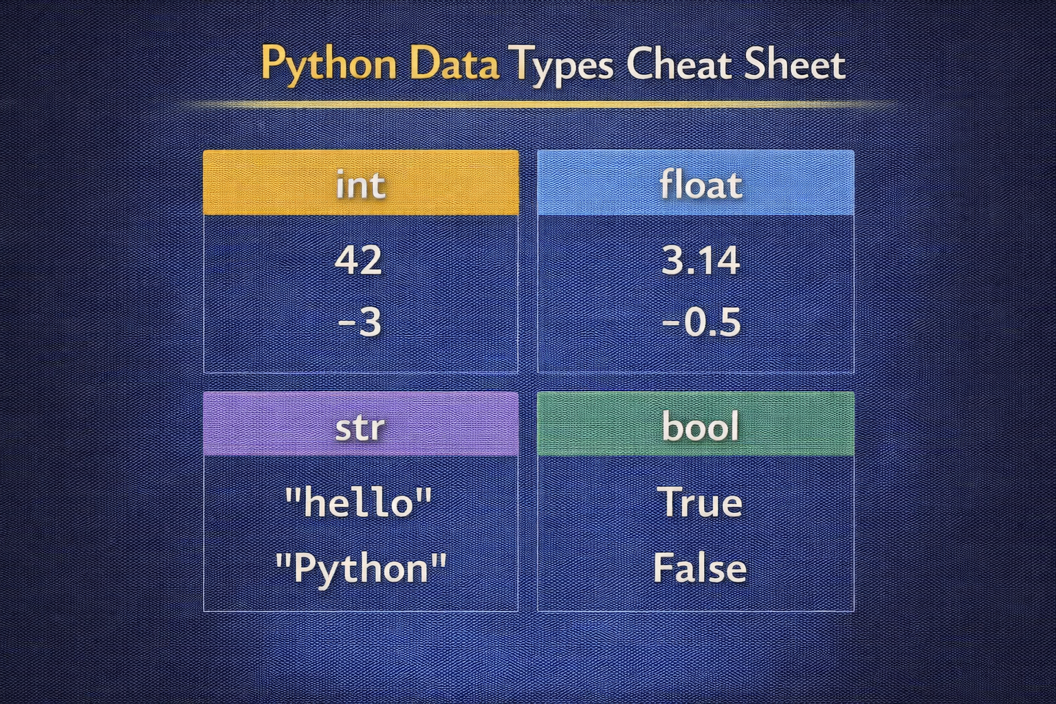
DAY 1 · PYTHON REVIEW
Variables & Data Types
The building blocks of every Python program
INTEGER
FLOAT
STRING
BOOLEAN
int
float
str
bool
age = 25
price = 19.99
name = "AI"
active = True
VARIABLE ASSIGNMENT
AI Tip
# Python variable assignment
learning_rate = 0.001
epochs = 100
model_name = "neural_net"
is_trained = False
# Multiple assignment
x, y, z = 1, 2, 3
Use descriptive variable names like learning_rate instead of lr for better readability.
Consistent naming makes code self-documenting and easier to maintain in team environments.

Slide 5
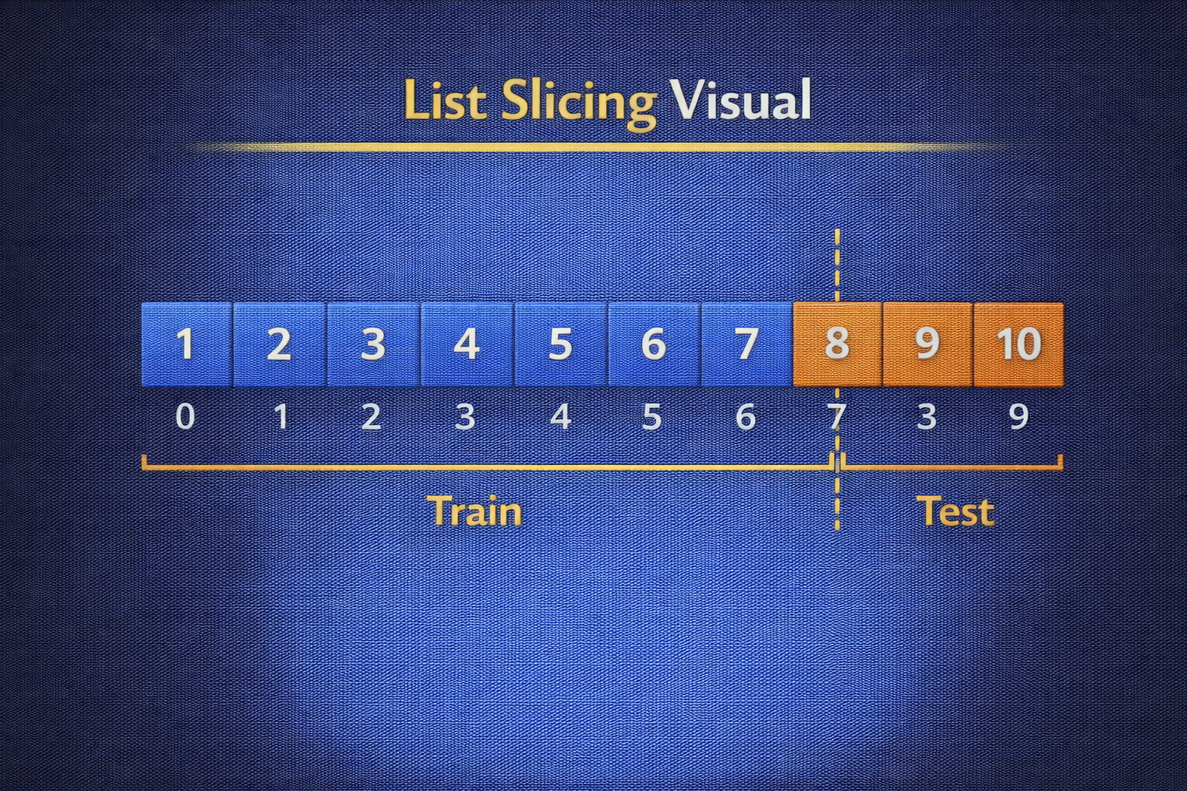
DAY 1 · PYTHON REVIEW
Lists & Collections
Storing and manipulating sequences of data
CREATING LISTS
SLICING - ESSENTIAL FOR AI
features = [0.5, 1.2, 3.4, 2.1]
labels = ["cat", "dog", "bird"]
# Common operations
features.append(4.5) # Add element
features.pop() # Remove last
len(features) # Get length
data = [0, 1, 2, 3, 4, 5, 6, 7, 8, 9]
train = data[:8] # First 8 elements
test = data[8:] # Last 2 elements
# 80/20 split pattern
train = data[:int(len(data)*0.8)]
AI Use Cases
Key Insight
• Store feature vectors and embeddings
• Hold training/test data splits
• Batch data samples for training
• Store model predictions and labels
List slicing is fundamental to creating train/test splits, batching data, and extracting subsets for cross-validation.

Slide 6
DAY 1 · PYTHON REVIEW
Control Flow
Making decisions and repeating actions in code
CONDITIONALS (if/elif/else)
FOR LOOP
accuracy = 0.85
if accuracy >= 0.9:
print("Excellent model!")
elif accuracy >= 0.8:
print("Good model")
else:
print("Needs improvement")
# Iterate over epochs
for epoch in range(10):
train_model()
print(f"Epoch {epoch} complete")
# Enumerate for index + item
for i, item in enumerate(data):
process(i, item)
WHILE LOOP
AI Pattern
while loss > 0.01:
loss = update_weights()
if converged: break
Training loops typically use for loops with range(epochs), while convergence checks use while loops.

Slide 7
DAY 1 · PYTHON REVIEW
List Comprehensions
Concise syntax for creating and transforming lists
Syntax
squares = [x**2 for x in range(10)]
[expression for item in iterable]
[expression for item in iterable if condition]
TRADITIONAL (5 lines)
LIST COMPREHENSION (1 line)
squares = []
for x in range(10):
squares.append(x**2)
# Result: [0, 1, 4, 9, 16, ...]
squares = [x**2 for x in range(10)]
# Same result, 60% less code
# Standard in professional AI codebases
AI EXAMPLES
normalized = [(x - min_val) / range_val for x in features] # Feature scaling
valid = [s for s in samples if s["label"] is not None] # Filter invalid

Slide 8
DAY 1 · PYTHON REVIEW
String Operations
Essential for text preprocessing in NLP tasks
COMMON STRING METHODS
F-STRINGS (Python 3.6+)
text = " Hello World "
text.lower() # " hello world "
text.upper() # " HELLO WORLD "
text.strip() # "Hello World"
text.split() # ["Hello", "World"]
text.replace("o", "0") # "Hell0 W0rld"
model = "ResNet"
acc = 0.956
print(f"{model}: {acc:.2%}")
# Output: ResNet: 95.60%
print(f"Epoch {epoch:03d}/100")
# Output: Epoch 005/100
NLP PREPROCESSING PIPELINE
NLP Importance
def preprocess(text):
text = text.lower() # Lowercase
text = text.strip() # Remove whitespace
tokens = text.split() # Tokenize
return tokens
String operations are fundamental for cleaning text data before feeding to models.

Slide 9
DAY 1 · PYTHON REVIEW
Writing Modular Code
Breaking down complex workflows into reusable components
BEFORE: Repeated Code ❌
AFTER: Modular Function ✓
# Process dataset 1
data1 = load_csv("train.csv")
data1 = data1.dropna()
data1["price"] *= 1.1
save_csv(data1, "train_clean.csv")
# Process dataset 2 (same code!)
# 8+ lines repeated - high bug risk
def process_dataset(in_path, out_path):
"""Clean and transform dataset."""
data = load_csv(in_path)
data = data.dropna()
data["price"] *= 1.1
save_csv(data, out_path)
# Now just 2 calls! Easy to test.
Problem
Solution
• Code duplication increases bug risk
• Changes needed in multiple places
• Hard to test and maintain
• Single function to update
• Easy to write unit tests
• Consistent behavior guaranteed

Slide 10
DAY 1 · PYTHON REVIEW
From Scripts to Reusable AI Utilities
Turn one-off scripts into testable, reusable ML components
EXAMPLE: METRIC UTILITIES
Engineering Notes
from typing import Sequence, Dict
def accuracy(preds: Sequence[int], labels: Sequence[int]) -> float:
"""Compute classification accuracy."""
correct = sum(p == y for p, y in zip(preds, labels))
return correct / len(labels) if labels else 0.0
def classification_report(preds, labels) -> Dict[str, float]:
"""Return a metrics dict (extend later)."""
return {"accuracy": accuracy(preds, labels)}
• Keep functions small - single concept
• Use type hints to document expectations
• Place in metrics.py module
ML Impact
Shared metric utilities reduce bugs when comparing different models.
USAGE
# Import and use across projects
from metrics import accuracy, classification_report
acc = accuracy(predictions, ground_truth)

Slide 11
DAY 1 · ACTIVITY
Refactoring Challenge
Transform repeated code into clean, modular functions
Your Task
SAMPLE INPUT
1. Identify repeated code patterns
2. Create functions with clear parameters
3. Add docstrings for documentation
4. Test that output matches original
5. Use meaningful variable names
cat_a = [1, 2, 3, 4, 5]
mean_a = sum(cat_a) / len(cat_a)
max_a = max(cat_a)
EXPECTED OUTPUT
def calculate_stats(data):
return {"mean": ..., "max": ...}
Requirements
• At least 3 reusable functions • Docstrings for each • Descriptive variable names • No repeated code blocks | Time: 20-30 minutes

Slide 12
DAY 1 · ASSESSMENT
Code Submission
A Python script demonstrating modular design
Submission Checklist
Grading Criteria
✓ At least 3 reusable functions
✓ Docstrings for each function
✓ Descriptive variable names
✓ No repeated code blocks
✓ Working output matches original
40% - Functionality (code works correctly)
30% - Code Quality (clean, readable)
30% - Documentation (docstrings, comments)
EXAMPLE STRUCTURE
def calculate_stats(data):
"""Calculate statistics for a list of numbers.
Args: data: List of numerical values
Returns: Dict with mean, max, min values
"""
return {"mean": sum(data)/len(data), "max": max(data), "min": min(data)}

Slide 13
DAY 2
Functions
Building Modular AI Code
OBJECTIVES
ACTIVITY
• Master advanced function concepts in depth
• Understand scope and return values
• Learn *args, **kwargs for flexibility
• Create reusable utility libraries
Create a library of utility functions for common data tasks.
ASSESSMENT
Mini-quiz on function scope and arguments.
Week 1 · Advanced Python for AI

Slide 14
DAY 2 · FUNCTIONS
Function Fundamentals
The building blocks of maintainable AI systems
BASIC SYNTAX
EXAMPLE
def function_name(parameters):
"""Docstring describing function."""
# Function body
return result
def calculate_accuracy(correct, total):
"""Calculate accuracy as percentage."""
return (correct / total) * 100
acc = calculate_accuracy(85, 100) # 85.0
70%
Key Concepts
Reduction in code duplication
• def keyword for definition • Parameters and arguments • Return values • Scope and variable lifetime • Docstrings for documentation

Slide 15
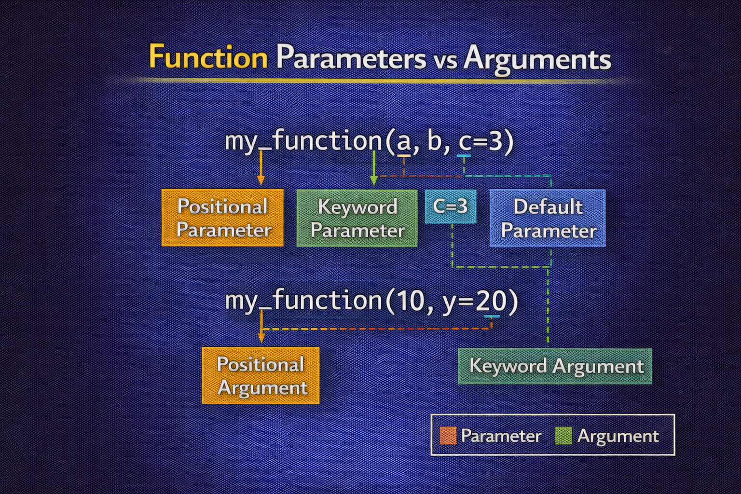
DAY 2 · FUNCTIONS
Parameters and Arguments
Flexible ways to pass data into functions
POSITIONAL ARGS
KEYWORD ARGS
DEFAULT VALUES
def train(model, epochs, lr):
pass
train("ResNet", 100, 0.001)
train(
model="ResNet",
lr=0.001,
epochs=100
)
def train(model,
epochs=100,
lr=0.001):
pass
Best Practice
Put required parameters first, optional parameters with defaults last. This makes function calls cleaner and intentions clearer.
train("ResNet") # Uses all defaults
train("ResNet", epochs=200) # Override just epochs

Slide 16
DAY 2 · FUNCTIONS
*args and **kwargs
Handling flexible function signatures
*args - Variable Positional
**kwargs - Variable Keyword
def sum_all(*numbers):
"""Accept any number of arguments."""
return sum(numbers)
sum_all(1, 2, 3, 4, 5) # 15
def create_config(**settings):
"""Accept any keyword arguments."""
return settings
config = create_config(lr=0.01, epochs=50)
AI USE CASE: FLEXIBLE MODEL CONFIGURATION
def build_model(architecture, **hyperparams):
"""Build model with flexible hyperparameters."""
model = load_architecture(architecture)
model.configure(**hyperparams) # Pass all settings to model
return model
model = build_model("ResNet", lr=0.001, dropout=0.5, batch_size=32)

Slide 17
DAY 2 · FUNCTIONS
Return Values
Getting results back from functions
SINGLE RETURN
MULTIPLE RETURNS
RETURN DICT
def get_accuracy(pred, labels):
correct = sum(
p == l for p, l
in zip(pred, labels)
)
return correct / len(labels)
def train_test_split(data):
split = int(len(data)*0.8)
return data[:split], data[split:]
train, test = train_test_split(data)
def evaluate(model):
return {
"accuracy": 0.95,
"precision": 0.93,
"recall": 0.94
}
Pro Tip
Use tuple unpacking for multiple returns, or return a dictionary for named results that are self-documenting.

Slide 18
DAY 2 · FUNCTIONS
Variable Scope
Understanding where variables live
LOCAL SCOPE
GLOBAL SCOPE
def calculate():
x = 10 # Local variable
return x
print(x) # Error! x not defined
# x only exists inside the function
learning_rate = 0.001 # Global
def train():
print(learning_rate) # Can READ global
def update_lr():
global learning_rate # Declare global
learning_rate = 0.0001
LEGB Rule
Best Practice
Local → Enclosing → Global → Built-in
Python searches for variables in this order.
Avoid global variables. Pass values as parameters instead for clearer, testable code.

Slide 19
DAY 2 · FUNCTIONS
Docstrings
Documenting functions for collaboration
GOOGLE STYLE DOCSTRING
Why Document?
def normalize(data, method="minmax"):
"""Normalize data using specified method.
Args:
data: List of numerical values
method: Normalization method ("minmax" or "zscore")
Returns:
List of normalized values
Raises:
ValueError: If method not recognized
"""
pass
• IDE shows docs on hover
• Auto-generates API docs
• Helps team collaboration
• Essential for open-source
• Self-documenting code
• Easier maintenance

Slide 20
DAY 2 · FUNCTIONS
Higher-Order Functions
Functions that work with other functions
PASSING FUNCTIONS AS ARGS
BUILT-IN HIGHER-ORDER
def apply_to_all(func, data):
return [func(x) for x in data]
numbers = [1, 2, 3, 4]
squared = apply_to_all(
lambda x: x**2, numbers
) # [1, 4, 9, 16]
# map - apply to each
list(map(str.upper, ["a", "b"]))
# filter - keep if True
list(filter(lambda x: x > 0, nums))
# sorted with key function
sorted(data, key=lambda x: x["val"])
AI Use Case
Building preprocessing pipelines by composing transformation functions - each step is a function passed to the next.

Slide 21
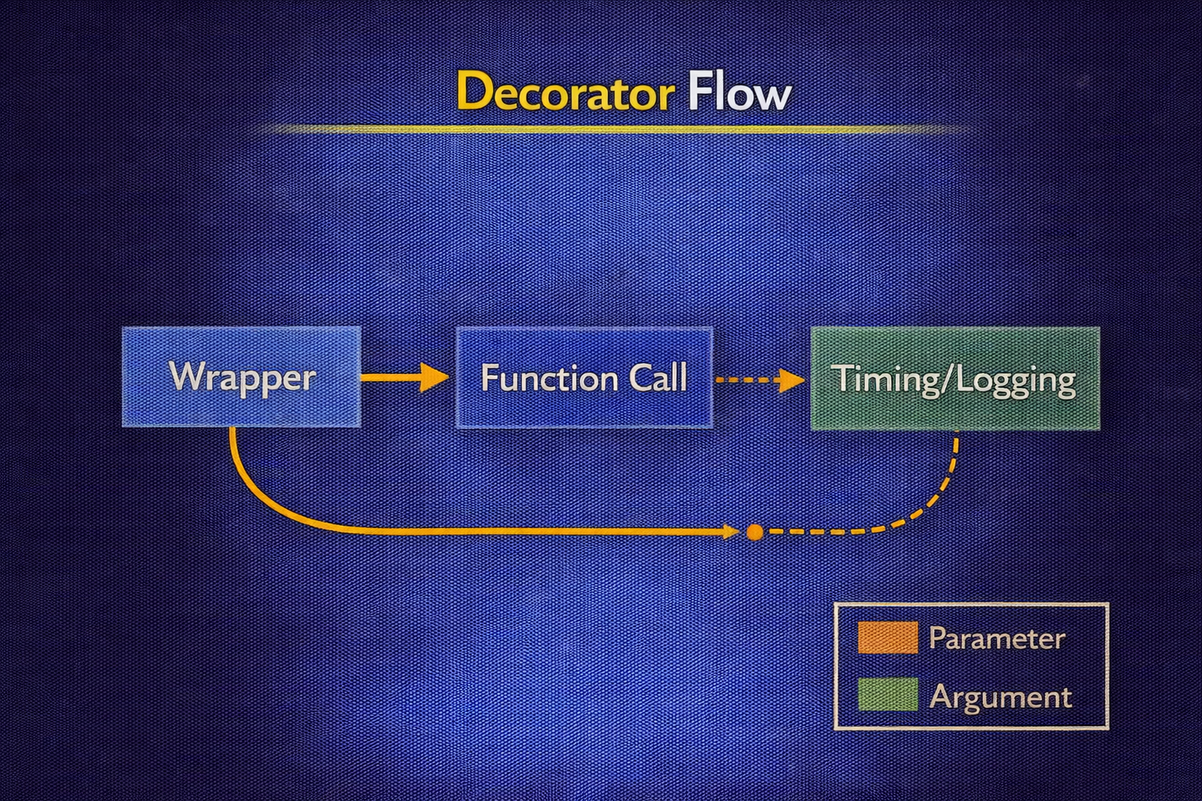
DAY 2 · FUNCTIONS
Decorators
Adding functionality to existing functions
TIMING DECORATOR
Common Use Cases
import time
def timer(func):
def wrapper(*args, **kwargs):
start = time.time()
result = func(*args, **kwargs)
print(f"{func.__name__} took {time.time()-start:.2f}s")
return result
return wrapper
@timer
def train_model(epochs):
# Training code...
pass
• Timing/profiling functions
• Logging function calls
• Caching results (memoization)
• Input validation
• Authentication checks
• Retry logic

Slide 22
DAY 2 · FUNCTIONS
Building a Utility Library
Common functions for AI data tasks
data_utils.py
Usage
def load_data(filepath):
"""Load data from CSV file."""
pass
def clean_missing(df, strategy="drop"):
"""Handle missing values."""
pass
def normalize(data, method="minmax"):
"""Normalize numerical data."""
pass
def split_data(X, y, test_size=0.2):
"""Split into train/test sets."""
pass
from data_utils import (
load_data,
clean_missing,
normalize
)
Benefits
• Reuse across projects
• Consistent behavior
• Easy to test
• Team standardization

Slide 23
DAY 2 · FUNCTIONS
Designing a Reusable data_utils Module
Turn common operations into a stable utility module
EXAMPLE STRUCTURE (data_utils.py)
Engineering Notes
from pathlib import Path
import pandas as pd
def load_csv(path: Path) -> pd.DataFrame:
"""Load CSV with minimal assumptions."""
return pd.read_csv(path)
def drop_missing(df: pd.DataFrame, cols: list[str]) -> pd.DataFrame:
"""Drop rows with missing values in required columns."""
return df.dropna(subset=cols)
def add_ratio(df: pd.DataFrame, num: str, denom: str, out: str):
"""Add a ratio feature like price_per_sqft."""
df = df.copy()
df[out] = df[num] / df[denom]
return df
• Keep I/O separate from transforms
• Return new DataFrames
• Use explicit column names
ML Impact
A stable data_utils module plugs into pipelines without rewrites. Consistency reduces bugs.

Slide 24
DAY 2 · ACTIVITY
Create Utility Functions
Build a library of reusable data functions
Required Functions
Bonus Points
1. calculate_statistics(data)
2. normalize_data(data, method)
3. remove_outliers(data, threshold)
4. train_test_split(data, ratio)
5. encode_labels(labels)
• Add type hints for all parameters
• Include comprehensive docstrings
• Write test cases for each function
• Handle edge cases (empty lists, etc.)
Time: 30-45 minutes
Create data_utils.py with at least 5 utility functions. Each function should have a docstring and handle edge cases.

Slide 25
DAY 2 · ASSESSMENT
Mini-Quiz: Functions
Test your understanding of function concepts
Topics Covered
Sample Questions
• Function definition and calling
• Parameters vs arguments
• *args and **kwargs usage
• Return values (single, multiple, dict)
• Variable scope (LEGB rule)
• Docstrings and documentation
1. Difference between parameter and argument?
2. When would you use **kwargs?
3. What does LEGB stand for?
4. Write a function returning multiple values.
Format
10 multiple choice + 2 coding questions | Time: 15 minutes

Slide 26
DAY 3
Lambda + .apply()
Functional Programming for Data Transformation
OBJECTIVES
ACTIVITY
• Write and use lambda functions for concise operations
• Apply functions to Pandas DataFrames using .apply()
• Understand performance considerations
• Build data cleaning pipelines
Use .apply() with lambda to clean a column (e.g., remove currency symbols).
ASSESSMENT
Notebook showing use of lambda and apply.
Week 1 · Advanced Python for AI

Slide 27
DAY 3 · LAMBDA + .APPLY()
Lambda Functions Basics
Anonymous inline functions
Syntax
lambda arguments: expression → Returns result of expression automatically
REGULAR FUNCTION
LAMBDA EQUIVALENT
def square(x):
return x ** 2
result = square(5) # 25
square = lambda x: x ** 2
result = square(5) # 25
Key Characteristics
• Single expression only - no multiple statements • Implicit return - no return keyword needed • No if/for blocks inside (use ternary for conditions) • Best for simple, one-time operations in functional contexts

Slide 28
DAY 3 · LAMBDA + .APPLY()
Lambda with Built-in Functions
Power combinations for data processing
WITH map()
WITH filter()
WITH sorted()
numbers = [1, 2, 3, 4, 5]
squared = list(map(
lambda x: x**2,
numbers
)) # [1, 4, 9, 16, 25]
numbers = [-2, -1, 0, 1, 2]
positive = list(filter(
lambda x: x > 0,
numbers
)) # [1, 2]
students = [
{"name": "A", "grade": 85},
{"name": "B", "grade": 92}
]
sorted(students,
key=lambda s: s["grade"])
When to Use
Lambda functions shine when used with map(), filter(), sorted(), and pandas .apply() - anywhere you need a quick, inline function.

Slide 29
DAY 3 · LAMBDA + .APPLY()
The .apply() Method
Pandas' most powerful transformation tool
What is .apply()?
prices_tax = prices.apply(lambda x: x * 1.1)
Applies a function to each element (Series) or row/column (DataFrame) in pandas.
SERIES.APPLY()
Why Use .apply()?
import pandas as pd
prices = pd.Series([100, 200, 150, 300])
prices_tax = prices.apply(lambda x: x * 1.1)
# 110.0, 220.0, 165.0, 330.0
• Apply custom logic to data
• Bridge pandas and Python functions
• Handle complex transformations
• Row-wise or column-wise operations

Slide 30
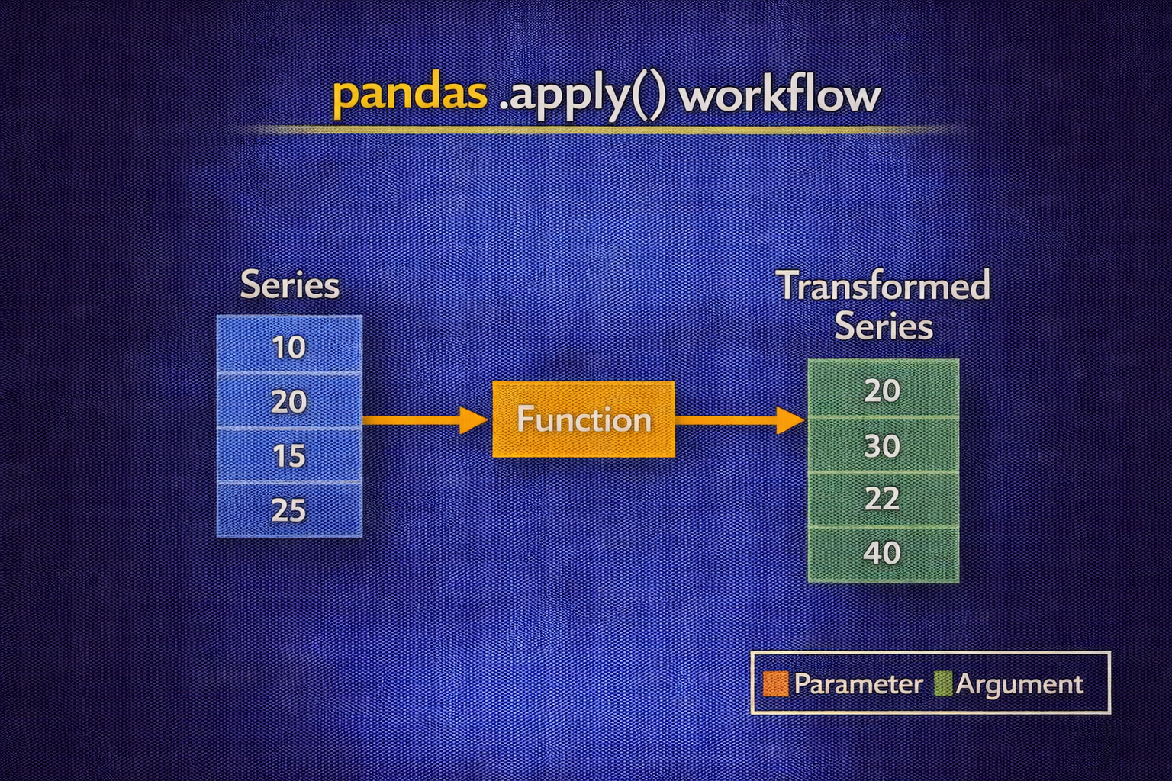
DAY 3 · LAMBDA + .APPLY()
.apply() on DataFrames
Column-wise and row-wise operations
COLUMN-WISE (axis=0)
ROW-WISE (axis=1)
df = pd.DataFrame({
"A": [1, 2, 3],
"B": [4, 5, 6]
})
df.apply(lambda col: col.max()) # A:3, B:6
df["sum"] = df.apply(
lambda row: row["A"] + row["B"],
axis=1
)
# Adds A and B for each row
APPLYING TO SPECIFIC COLUMN
df['A_squared'] = df['A'].apply(lambda x: x**2) # Square values in column A
df['B_log'] = df['B'].apply(lambda x: np.log(x)) # Log transform column B

Slide 31
DAY 3 · LAMBDA + .APPLY()
Lambda + apply() Examples
Real-world data transformations
TEXT CLEANING (NLP)
FEATURE SCALING
df["clean"] = df["text"].apply(
lambda x: x.lower().strip()
)
df["norm"] = df["value"].apply(
lambda x: (x - mean) / std
)
CATEGORICAL ENCODING
HANDLING MISSING
category_map = {"low": 0, "med": 1, "high": 2}
df["enc"] = df["cat"].apply(
lambda x: category_map.get(x, -1))
df["filled"] = df["val"].apply(
lambda x: 0 if pd.isna(x) else x
)
Data Cleaning Pipeline
These patterns are fundamental for NLP preprocessing and feature engineering in AI workflows.

Slide 32
DAY 3 · LAMBDA + .APPLY()
Performance Considerations
When to use each approach
VECTORIZED (PREFERRED) ⚡
USING .apply() 🐢
# FAST - Use pandas/numpy operations
df["double"] = df["value"] * 2
df["sum"] = df["A"] + df["B"]
# SLOWER - For complex logic only
df["result"] = df["text"].apply(
complex_nlp_function
)
Performance Comparison
Rule of Thumb
Vectorized: ~1x (baseline)
.apply() with lambda: ~10-100x slower
Python loop: ~100-1000x slower
1. Try vectorized operations first
2. Use .apply() for complex logic
3. Never use Python loops on DataFrames

Slide 33
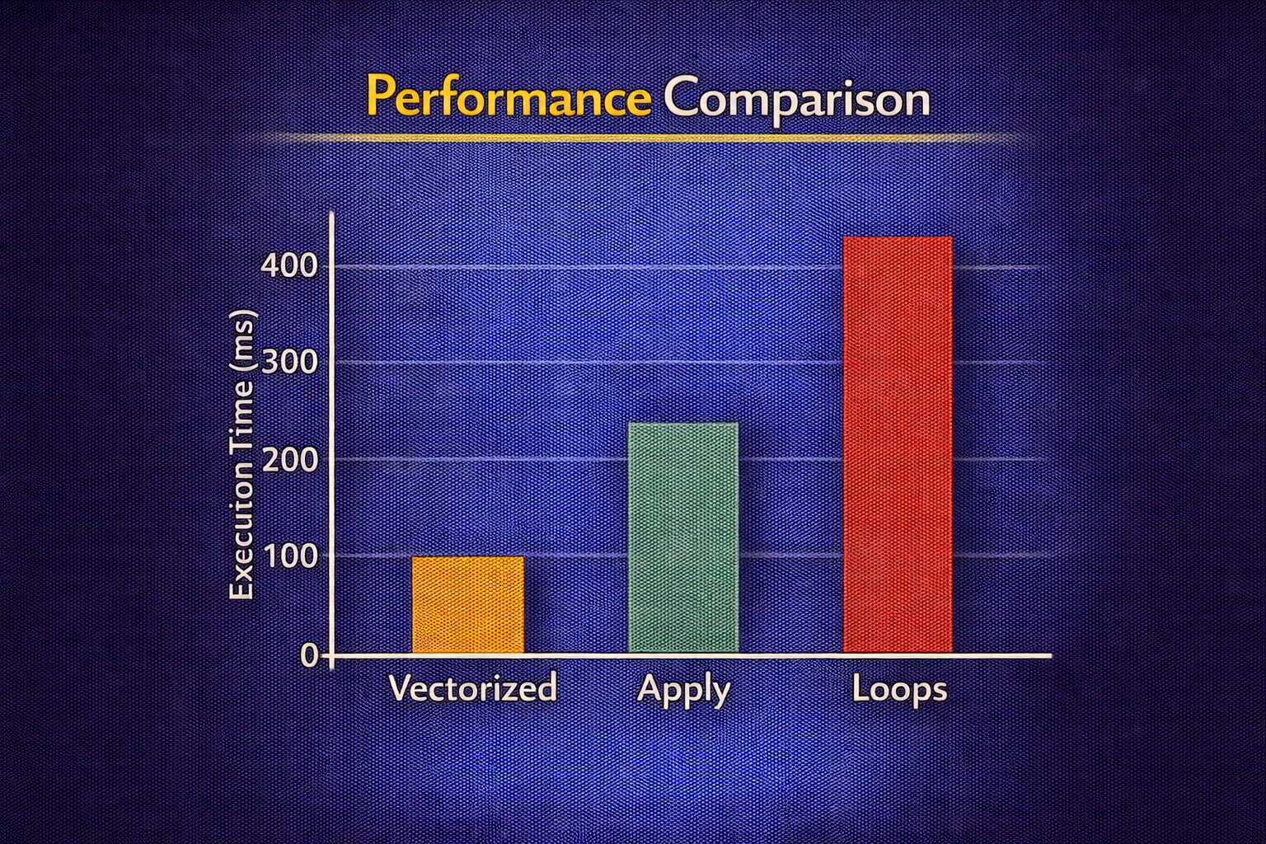
DAY 3 · LAMBDA + .APPLY()
Towards Vectorized ML Data Prep
Replace slow loops with vectorized operations
ANTI-PATTERN: ROW LOOP ❌
BETTER: VECTORIZED ✓
# Slow: explicit Python loop
def add_length_column(df):
lengths = []
for _, row in df.iterrows():
text = row["text"]
lengths.append(len(text.split()))
df["text_length"] = lengths
return df
# Fast: use Series methods
def add_length_column_vectorized(df):
df = df.copy()
df["text_length"] = df["text"].str.split().apply(len)
return df
# Even better with pure vectorization:
# df["text_length"] = df["text"].str.split().str.len()
ML Impact
Engineering Note
Faster preprocessing = faster experiment iteration
Prefer .str methods and .apply() over manual loops

Slide 34
DAY 3 · ACTIVITY
Clean a Dataset
Use .apply() with lambda to transform real data
Tasks
SAMPLE DATA
1. Clean price column (remove $ and ,)
2. Fill missing quantity with 0
3. Create total = price × quantity
4. Categorize price as low/med/high
product | price | quantity
Widget A | $1,234.50 | 10
Widget B | $567.89 | 5
Widget C | $2,345.00 | null
Requirements
Use .apply() with lambda for at least 2 transformations • Include comments • Time: 25-35 minutes

Slide 35
DAY 3 · ASSESSMENT
Notebook Submission
Demonstrating lambda and .apply()
Required Sections
Grading Rubric
1. Data Loading - Load provided CSV
2. Data Exploration - shape, dtypes, sample
3. Cleaning with .apply() - 3+ transforms
4. Verification - Prove it worked
5. Reflection - When is vectorized better?
25% - Correct lambda syntax
25% - Proper .apply() usage
20% - Code runs without errors
15% - Clean, commented code
15% - Insightful reflection

Slide 36
DAY 4
Dictionaries
Python's Data Powerhouse
OBJECTIVES
ACTIVITY
• Manipulate nested dictionaries and complex structures
• Understand dictionary comprehensions
• Store and access ML configurations
• Master dict unpacking and merging
Parse a complex nested dictionary representing a student database.
ASSESSMENT
Code challenge: Extract specific data from nested structure.
Week 1 · Advanced Python for AI

Slide 37
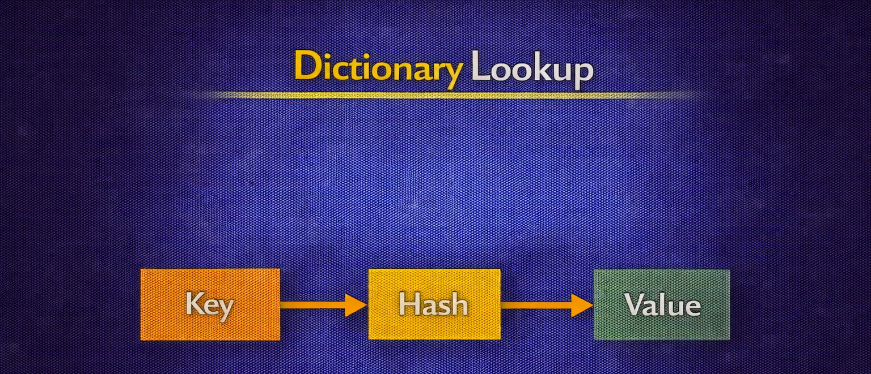
DAY 4 · DICTIONARIES
Dictionary Fundamentals
Key-value data storage with O(1) lookup
CREATING DICTIONARIES
ACCESSING VALUES
# Empty dictionary
config = {}
# With values
model_config = {
"learning_rate": 0.001,
"epochs": 100,
"batch_size": 32
}
# Direct access
lr = model_config["learning_rate"]
# Safe access with default
lr = model_config.get(
"learning_rate", 0.001
)
Why O(1)?
Dictionaries use hash tables for instant key lookup regardless of size - essential for caching, config management, and fast data access.

Slide 38
DAY 4 · DICTIONARIES
Common Dictionary Operations
Essential methods for working with dicts
ADDING / UPDATING
REMOVING
ITERATING
config["dropout"] = 0.5
config["epochs"] = 200
config.update({
"lr": 0.01,
"momentum": 0.9
})
# Delete key
del config["dropout"]
# Remove & return
val = config.pop("epochs")
# Clear all
config.clear()
config.keys()
config.values()
config.items()
for k, v in config.items():
print(f"{k}: {v}")
Concise dict creation
Syntax
{key_expr: value_expr for item in iterable} {key_expr: value_expr for item in iterable if condition}
SQUARE NUMBERS
FROM TWO LISTS
LABEL ENCODING
squares = {
x: x**2
for x in range(5)
} # {0:0, 1:1, 2:4, 3:9, 4:16}
keys = ["a", "b", "c"]
values = [1, 2, 3]
combined = {
k: v for k, v in zip(keys, values)
}
labels = ["cat", "dog"]
label_to_int = {
label: idx
for idx, label
in enumerate(labels)
}
AI Use Case
Label encoding, vocabulary mapping, feature indexing - all use dictionary comprehensions.

Slide 39
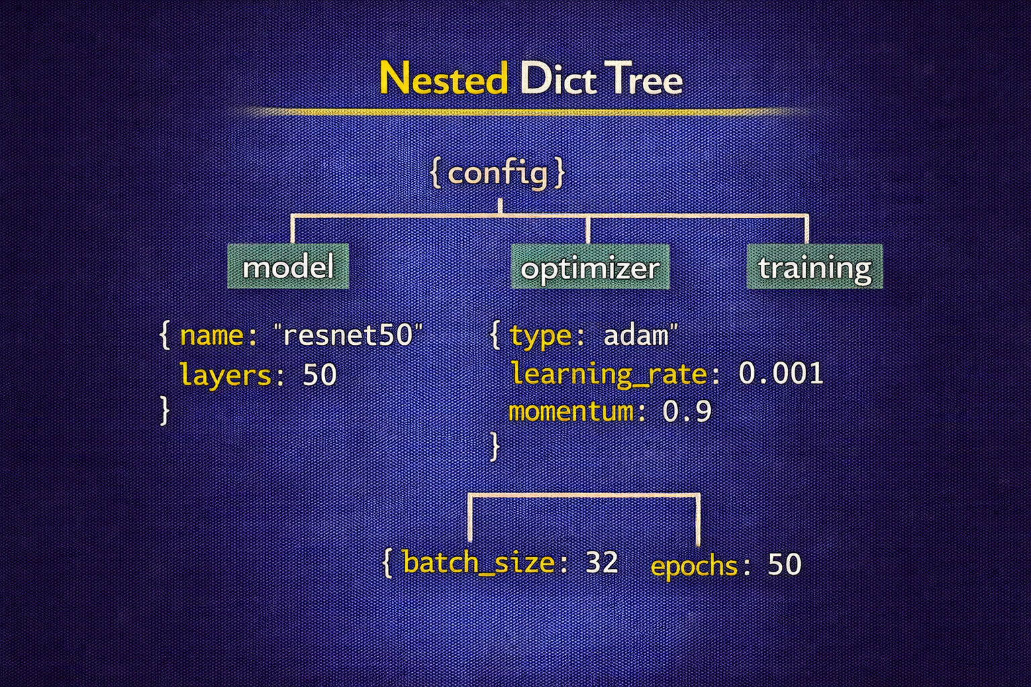
DAY 4 · DICTIONARIES
Nested Dictionaries
Complex hierarchical data structures
MODEL RESULTS STRUCTURE
ACCESSING NESTED
model_results = {
"experiment_1": {
"model": "ResNet50",
"metrics": {
"accuracy": 0.92,
"precision": 0.91,
"recall": 0.93
},
"hyperparams": {"lr": 0.001, "epochs": 100}
}
}
acc = model_results\
["experiment_1"]\
["metrics"]\
["accuracy"]
SAFE ACCESS
acc = model_results\
.get("exp_1", {})\
.get("metrics", {})\
.get("accuracy", 0)
Use .get() for safe nested access - avoids KeyError when keys might not exist.

Slide 40
DAY 4 · DICTIONARIES
Unpacking & Merging
Combining dictionaries efficiently
DICTIONARY UNPACKING (**)
UNPACKING IN FUNCTION CALLS
default = {"lr": 0.001, "epochs": 100}
user = {"lr": 0.01, "momentum": 0.9}
# Merge - user overrides default
final = {**default, **user}
# {"lr": 0.01, "epochs": 100, "momentum": 0.9}
def train(lr, epochs, batch):
pass
config = {"lr": 0.001, "epochs": 100, "batch": 32}
train(**config) # Unpacks as keyword args
Python 3.9+ Merge Operator
final_config = default_config | user_config # Cleaner syntax for merging

Slide 41
DAY 4 · DICTIONARIES
Model Configuration Patterns
Use nested dicts for training configurations
EXAMPLE: MODEL CONFIG DICT
Engineering Notes
model_config = {
"architecture": "resnet18",
"input_dim": 224,
"num_classes": 10,
"optimizer": {
"type": "adam",
"lr": 1e-3,
"weight_decay": 1e-4,
},
"training": {
"batch_size": 64,
"epochs": 20,
},
}
• Maps to JSON/YAML configs
• Group related settings
• Avoid flat configs with dozens of keys
ML Impact
Dict-based configs plug into JSON handling and training pipelines directly.

Slide 42
DAY 4 · ACTIVITY
Parse Student Database
Extract information from nested dictionaries
STUDENT DATABASE
Tasks
students = {
"S001": {
"name": "Alice Chen",
"courses": {
"CS101": {"grade": 92, "credits": 3},
"MATH201": {"grade": 88, "credits": 4},
"AI301": {"grade": 95, "credits": 3}
},
"advisor": "Dr. Smith"
},
"S002": {...}
}
1. Get Alice's AI301 grade
2. Calculate Bob's GPA
3. Find all students in CS101
4. Get average grade across all
5. Find student with highest GPA
Time: 25-30 minutes

Slide 43
DAY 4 · ASSESSMENT
Code Challenge: Data Extraction
Extract specific data from nested structures
Challenge Tasks
Evaluation
Given a nested dict of AI experiments:
1. Find best performing model name
2. List all learning rates used
3. Calculate average accuracy per model
4. Find experiments with >90% accuracy
50% - Correctness (outputs are correct)
25% - Code efficiency (no unnecessary loops)
25% - Code readability (clear variable names)
Time: 20 minutes

Slide 44
DAY 5
JSON + File Handling
Data Persistence for AI Workflows
OBJECTIVES
ACTIVITY
• Parse and manipulate JSON files for API data
• Perform file handling operations for data I/O
• Learn Git version control basics
• Create config-driven training scripts
Git & GitHub Mini-Workshop: Create repo, upload notebook, learn version control.
ASSESSMENT
GitHub repository with uploaded Jupyter notebooks.
Week 1 · Advanced Python for AI

Slide 45
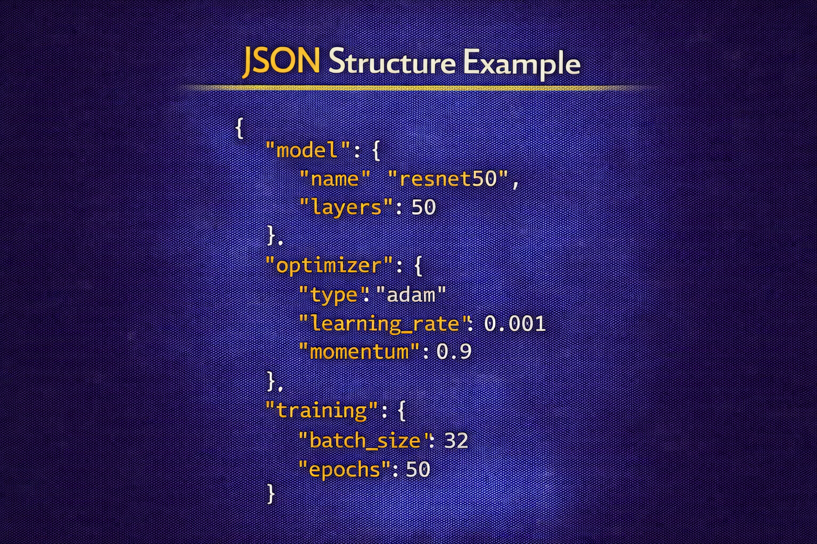
DAY 5 · JSON + FILE HANDLING
JSON: The Universal Data Format
Standard for AI data exchange
JSON STRUCTURE
JSON ↔ Python Mapping
{
"model": "GPT-4",
"accuracy": 0.95,
"tags": ["nlp", "transformer"],
"config": {
"layers": 96,
"attention_heads": 96
}
}
JSON object { } → Python dict
JSON array [ ] → Python list
JSON string → Python str
JSON number → Python int/float
true/false → True/False
null → None
Used in 90% of AI APIs and model serving systems. Human-readable and machine-parseable.

Slide 46
DAY 5 · JSON + FILE HANDLING
Python's json Module
Reading and writing JSON data
PARSE JSON STRING → PYTHON
PYTHON → JSON STRING
import json
data = json.loads('{"name": "AI"}')
# Returns: {"name": "AI"}
json_str = json.dumps({"name": "AI"})
# Returns: '{"name": "AI"}'
READ JSON FILE → PYTHON
PYTHON → WRITE JSON FILE
with open("config.json", "r") as f:
config = json.load(f)
with open("config.json", "w") as f:
json.dump(config, f, indent=4)
PRETTY PRINTING
print(json.dumps(data, indent=4, sort_keys=True))

Slide 47
DAY 5 · JSON + FILE HANDLING
File Handling in Python
Reading and writing files safely
THE with STATEMENT
File Modes
with open("data.txt", "r") as f:
content = f.read()
# File automatically closed after block
# Even if an exception occurs
"r" - Read (default)
"w" - Write (overwrites existing)
"a" - Append to end
"r+" - Read and write
"b" - Binary mode ("rb", "wb")
Why Use with?
• Automatically closes file when done • Handles exceptions properly • Prevents resource leaks • Cleaner than try/finally

Slide 48
DAY 5 · JSON + FILE HANDLING
Reading File Content
Different methods for different needs
READ ENTIRE FILE
READ AS LIST
LINE BY LINE
with open("data.txt") as f:
content = f.read()
# Returns entire file
# as single string
with open("data.txt") as f:
lines = f.readlines()
# Returns list of
# lines with \n
with open("big.txt") as f:
for line in f:
process(line)
# Memory efficient
Best Practice
For large files, iterate line-by-line to avoid loading entire file into memory. Use .strip() to remove newlines.
Creating and modifying files
WRITE STRING
APPEND TO FILE
WRITE JSON
with open("out.txt", "w") as f:
f.write("Hello, AI!\n")
f.write("Second line\n")
with open("log.txt", "a") as f:
f.write(f"[{time}] Started\n")
results = {
"accuracy": 0.95,
"loss": 0.05
}
json.dump(results, f)
Note
'w' mode overwrites existing files. Use 'a' mode to append. Always use with statement for safety.

Slide 49
DAY 5 · JSON + FILE HANDLING
Complete AI Workflow
Config → Train → Save Results
COMPLETE WORKFLOW PATTERN
Steps
# 1. Load Configuration
with open("config.json", "r") as f:
config = json.load(f)
print(f"Training with {config['epochs']} epochs...")
# 2. Training Process (simplified)
results = {"accuracy": 0.95, "loss": 0.04}
# 3. Save Results
try:
with open("results.json", "w") as f:
json.dump(results, f, indent=4)
print("Results saved!")
except IOError as e:
print(f"Failed to save: {e}")
1. Load hyperparams
2. Initialize model
3. Execute training
4. Save results
This pattern appears in 95% of production AI systems.

Slide 50
DAY 5 · JSON + FILE HANDLING
Config-Driven Training Scripts
Load hyperparameters from JSON
config.json
PYTHON LOADER
{
"model": "resnet18",
"epochs": 20,
"batch_size": 64,
"learning_rate": 0.001
}
def load_training_config(path: str):
with open(path, "r") as f:
return json.load(f)
cfg = load_training_config("config.json")
print(f"Training {cfg['model']}...")
Engineering Notes
ML Impact
• Easy to track and change hyperparameters
• Save config alongside results for tracking
Config files are the primary interface between researchers and training infrastructure.

Slide 51
DAY 5 · GIT WORKSHOP
Git & GitHub Workshop
Version control for AI projects
Workshop Objectives
Why Version Control?
1. Create and configure GitHub account
2. Understand Git fundamentals
3. Create repository for AI course
4. Upload Jupyter notebooks
5. Learn basic version control
6. Understand branching basics
• 98% of AI teams use Git
• Track experiment history
• Collaborate with team members
• Reproduce any previous state
• Professional development practice
BASIC GIT WORKFLOW
git add . → git commit -m "Add training script" → git push origin main

Slide 52
DAY 5 · ACTIVITY
Git & GitHub Workshop Tasks
Hands-on version control
Part 1: Setup (10 min)
Part 2: First Repo (10 min)
Part 3: Upload (10 min)
1. Create GitHub account
2. Install Git locally
3. Configure name and email
1. Create repo: ai-course-week1
2. Add README.md
3. Clone to local machine
1. Add Day 1-4 notebooks
2. Write commit messages
3. Push to GitHub
COMMANDS TO KNOW
git add . # Stage all changes
git commit -m "Add Day 1 notebook" # Commit with message
git push origin main # Push to GitHub

Slide 53
DAY 5 · ASSESSMENT
GitHub Repository Submission
Your AI course portfolio
Required Contents
REPOSITORY STRUCTURE
• README.md with project description
• Day 1-4 Jupyter notebooks
• At least 5 commits with messages
• Clean file organization
ai-course-week1/
├── README.md
├── day1/
│ └── python_review.ipynb
├── day2/
│ └── functions.ipynb
├── day3/
│ └── lambda_apply.ipynb
└── day4/
└── dictionaries.ipynb
Grading
25% Repo structure • 25% Commit quality • 25% README • 25% All notebooks present

Slide 54
Week 1 Complete!
Advanced Python for AI - Key Takeaways
Day 1
Python fundamentals, list comprehensions, modular code design
Day 2
Functions, scope, decorators, building utility libraries
Day 3
Lambda functions, .apply() method, vectorized operations
Day 4
Dictionaries, nested structures, comprehensions, configs
Day 5
JSON handling, file I/O, Git version control
Key Takeaway
Clean, modular Python code is the foundation of professional ML development. Master these fundamentals before diving into ML libraries.
Next Week: NumPy, Pandas, and Data Visualization

